Slide 1
Bangladesh
Presented by
Arka Bhuiyan
Md. Habibullah Rakib

Slide 2
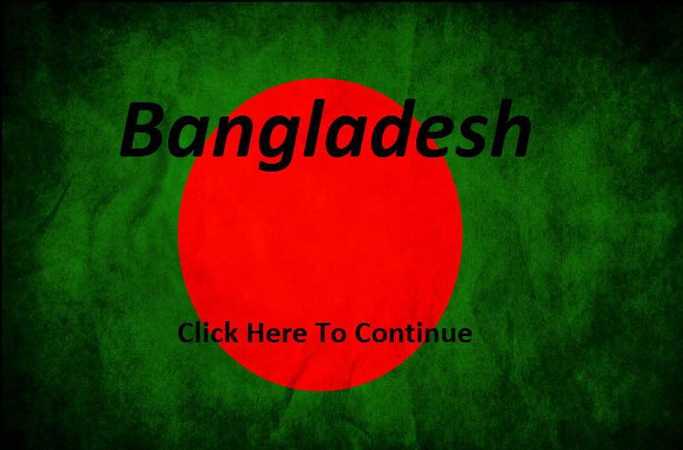
What is Bangladesh?
1. Bangladesh is an informative application.
2. Bangladesh is actually an independent country of south Asia.
3.Has been coded in c programming language, with the help of Borland Graphics Interface (BGI).
4. Compiled in codeblocks successfully.

Slide 3
The motto of the project
1. Implementation of C programming language.
2. Learning some basic graphics operations and increasing ability over loop and conditional statements.
3. Producing something very effective and very demandable.

Slide 4
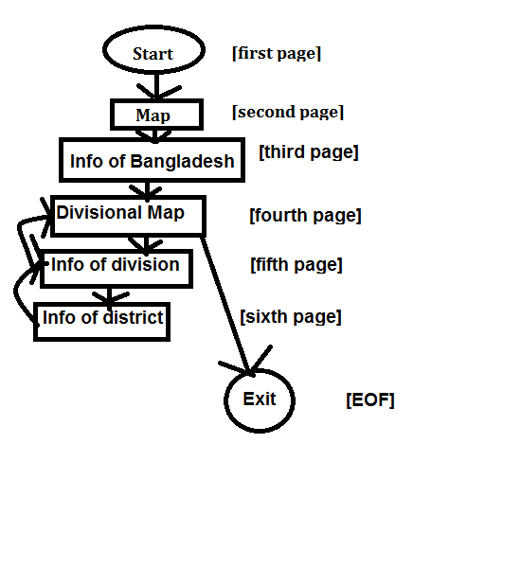
Application structure

Slide 5
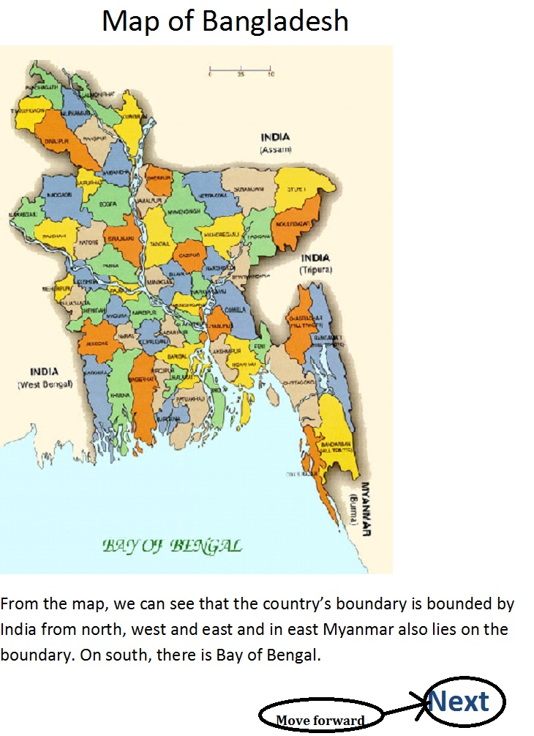
How to operate(1)
.In each part of the application, the user need to click on the highlighted words and go forward or backward

Slide 6
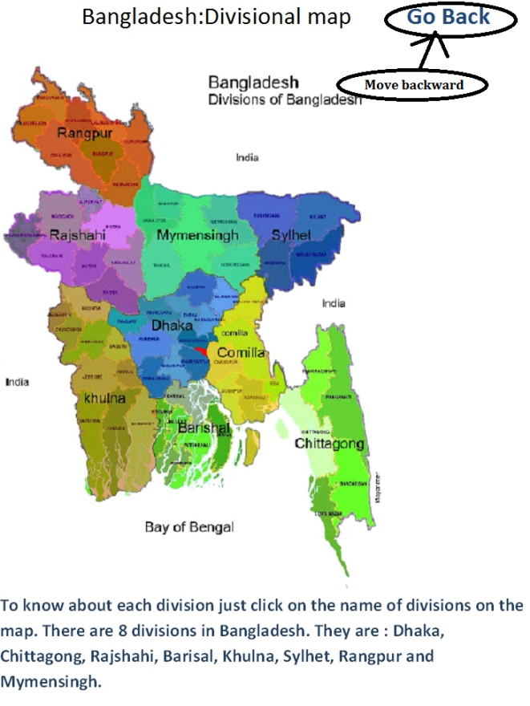
How to operate(2)

Slide 7
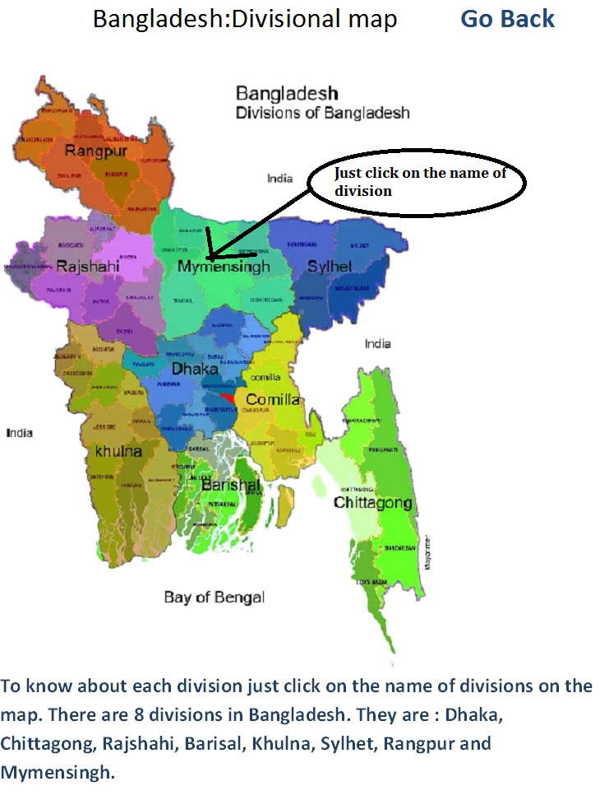
How to operate(3)
When an user attempt to read something about a division or district, he just needs to go to the divisional map and simply click on the name of the division on the map.

Slide 8
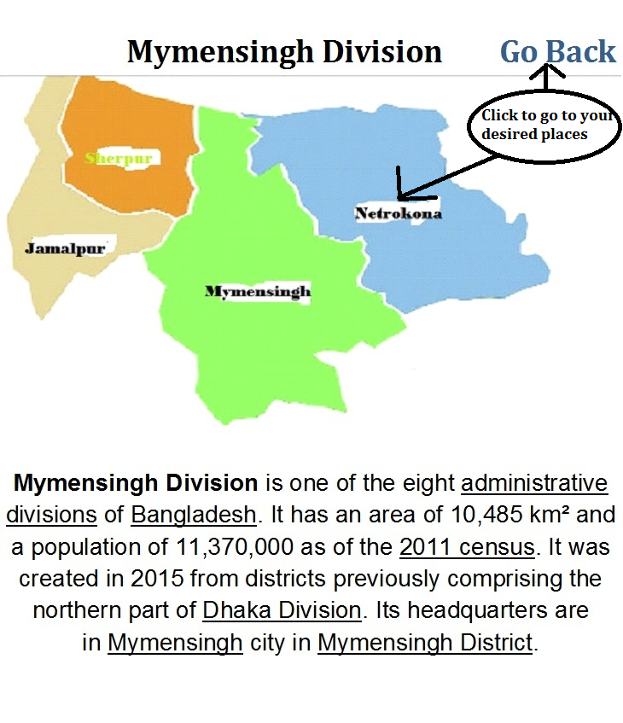
How to operate(4)
Same for district and if u want to go back to previous page, simply click on the “Go Back” command.

Slide 9
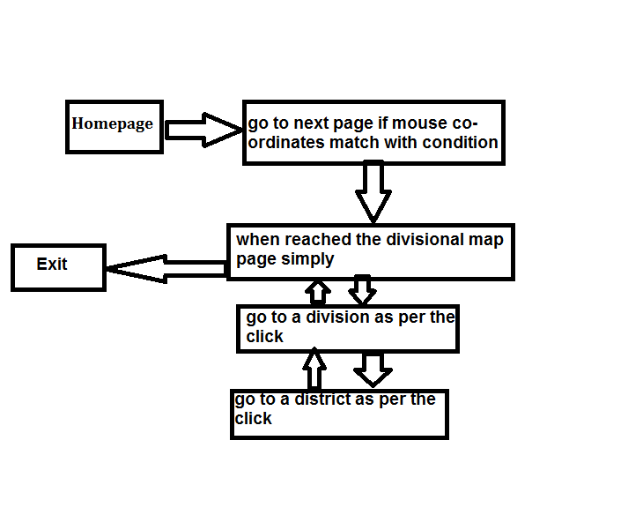
Algorithm and flowchart

Slide 10
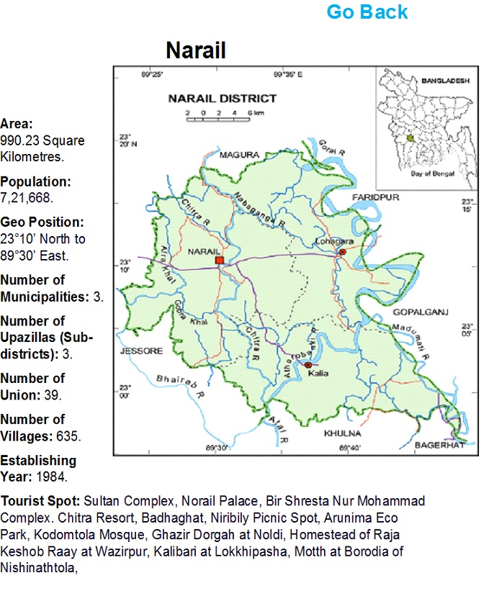
Special feature
Here one can get to see the map at the same time he can get to know about the district.

Slide 11
Special effects
We tried to keep an video effect by continuous image viewing and these images were the significant places of a particular zone.

Slide 12
Bugs
We did not find any serious bugs.
Wrong limit of mouse co-ordinates caused the program to crash; but it is fixed.

Slide 13
Tribute
To our countrymen and specially to the freedom-fighter; who gifted us an independent country.

Slide 14
Thank you!

Slide 15
Any questions?

